Slide 1
Agenda
Basics: TCP services, piggybacking, bytestream, connection
Connection setup & tear-down
Reliable Transfer: windows, timeouts, pipeline, cum. Acks, fast retransmission
RTT estimation

Slide 2
Piggybacking
So far, we’ve assumed distinct “sender” and “receiver” roles
In reality, usually both sides of a connection send some data
request/response is a common pattern
Client
Server
Client
Server
Request
Request
ACK
Response
Response + ACK
ACK
Request
Request + ACK
ACK
Response
Response + ACK
…
…
Without Piggybacking
With Piggybacking

Slide 3
A connection…
Requires stored state at two hosts.
Requires stored state within the network.
Establishes a path between two hosts.
1
1 & 3
1, 2 & 3
2
2 & 3

Slide 4

Connection Establishment (three-way handshake)
(Server)
bind(), listen()
LISTEN
connect()
(Client)
accept()
SYN_SENT
SYN, SequenceNum =
x
y
,
SYN_RCVD
SYN + ACK, SequenceNum =
+
1
x
Acknowledgment =
ESTABLISHED
connect() returns
eventually, send()
ACK, Acknowledgment =
(piggybacked data optional)
y
ESTABLISHED
+
1
accept() returns
Both sides agree on connection.

Slide 5
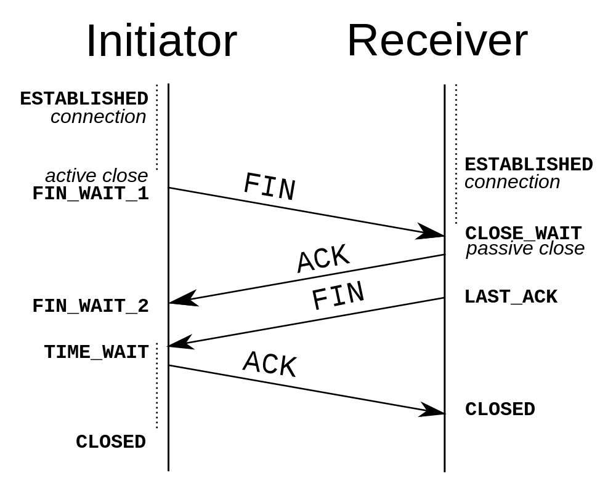
TCP Connection Teardown

